Slide 1

GKN, AESQ and Human Factors
The story behind my, GKN and
AESQ journey to this day
30 january 2025

Slide 2
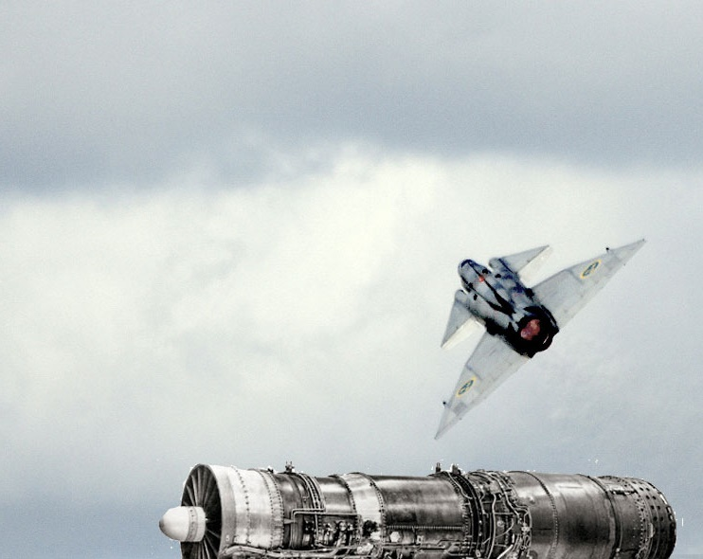
Håkans HF journey
Every year, a Viggen crashed
My colleges daughter flew Viggen
A lot of questions started to grow in my head…

Slide 3
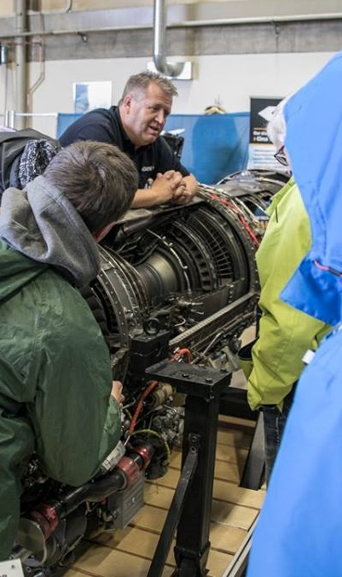
In our daily work - How do we react, act and make decisions?
University West
    2002 – 2003
    2010 - 2011
International Aerospace Quality Group, IAQG, in the People Capability Group and working with Human Factors issues
    2010 - 2013
Aerospace Engine Supplier Quality, AESQ, in the Human Factors Working Group
    2018 – 2020, 2022 - …
HFN – Human Factors Network in Sweden

Slide 4
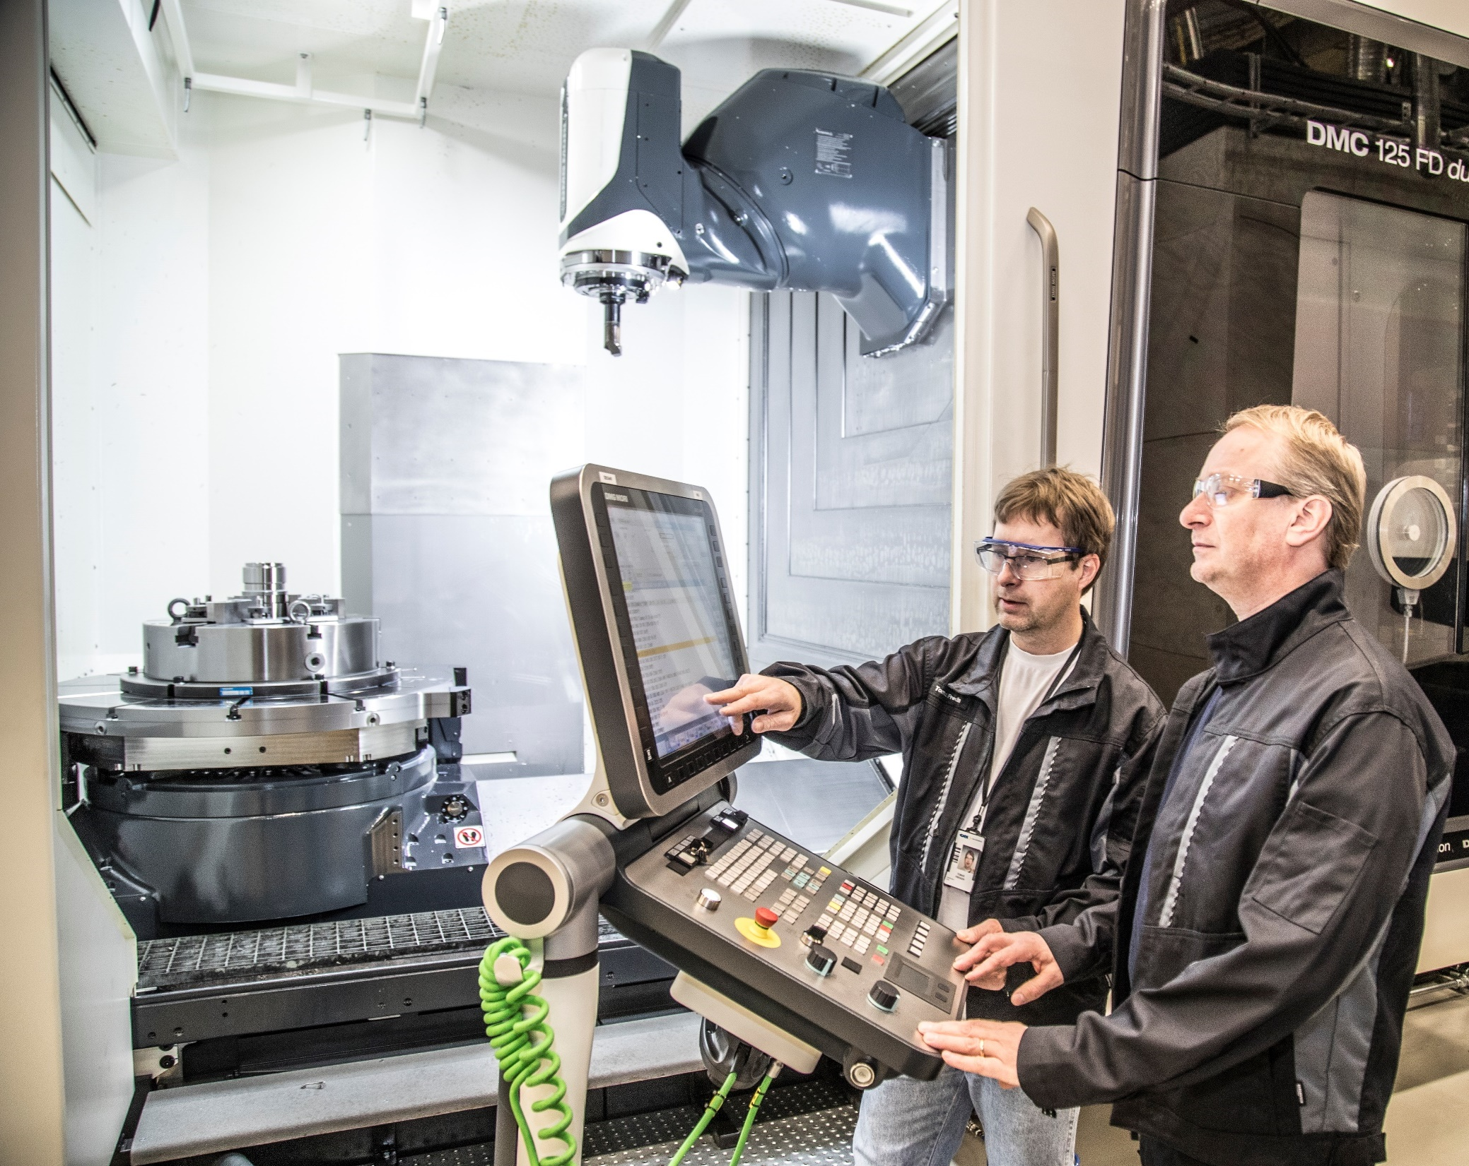
GKN Aerospace Engines Sweden
The Human Factors story at GKN Trollhättan
From Maintenance 2006 to all persons that affect Design, Production and Maintenance

Slide 5
Human Factors at GKN Aerospace Engines Thn, timeline
EASA 145 and RML
Maintenance
Rolls Royce
NDT
Code of ethics
AS13100
IAQG
AESQ
AESQ
2005
2006
2008
2009
2010
2014
2007
2011
2012
2013
2014
2016
2017
2018
2019
2020
2021
2022
2023
2024
2025
HF Maintenance
HF Production
HF Design Production
All co-workers
HF Management
Business Plan
HF Design
Notes:
… from Business Plan “popular version” published in August 2008
” Product quality and safety is often regarded as synonyms in the airline industry and aviation security is the cornerstone of our quality work… … The most important area to improve is ' the human factor’.”
“ … –Right now investigated the certification of operators in the workshop and training program for "Human Factors" has started in the Engine Maintenance & assembly. The ambition is that everyone at Volvo Aero will go a similar training…”
Page 22, 23. Stefan Lund Quality Manager VAC

Slide 6

AEROSPACE ENGINE SUPPLIER QUALITY (AESQ) STRATEGY GROUP
In 2012, the President of Rolls-Royce Aerospace Supply Chain, and the Vice Presidents of Pratt & Whitney (Procurement), GE Aviation (Global Supply Chain), and Safran (Purchasing) tasked their respective senior quality executives to work collectively in driving rapid change throughout the aerospace engine supply base. The group subsequently formed the SAE G-22 Aerospace Engine Supplier Quality (AESQ) Technical Committee (2013) and the AESQ Strategy Group (2015) to collaboratively publish and deploy common quality supplier requirements.
VISION To enable and accelerate the achievement of Zero Defects and a quality first culture across the global aero engine supply chain.
KEY MESSAGE Work collaboratively to deploy the effective quality standards created by the AESQ Members throughout the entire aerospace engine supply chain

Slide 7

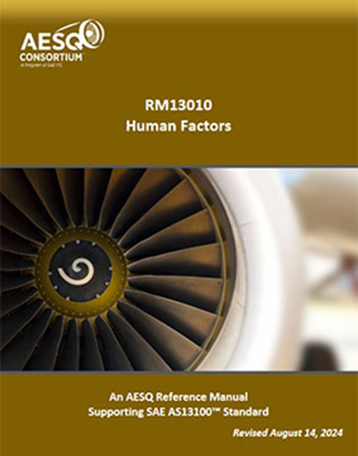
Human Factors Subject Matter Interest Group
The purpose of the Human Factors Subject Matter Interest Group is to promote the effective deployment of the SAE AS13100 Supplemental Quality Management Systems Requirements Standard and Reference Manual RM13010 Human Factors throughout the supply chain.
The key areas of focus for this group are:
Policy and Leadership
Communication
Training
Investigations
Reporting
Best Practices

Slide 8
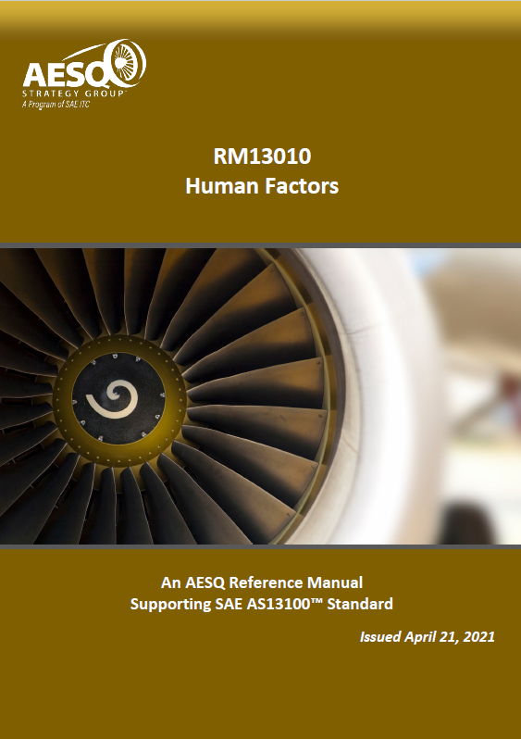
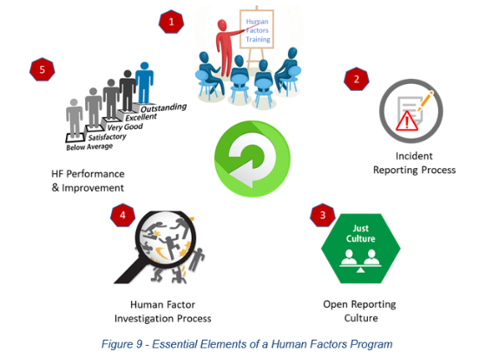
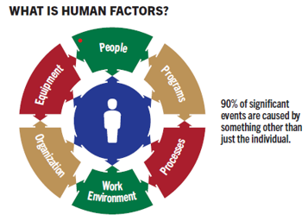
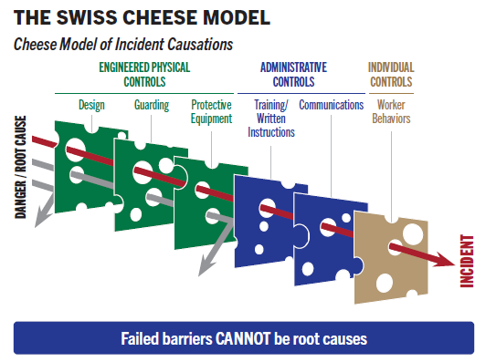
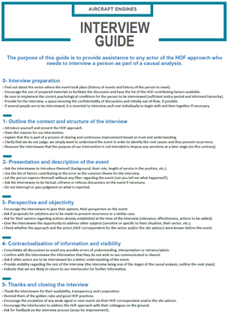

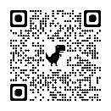
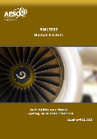
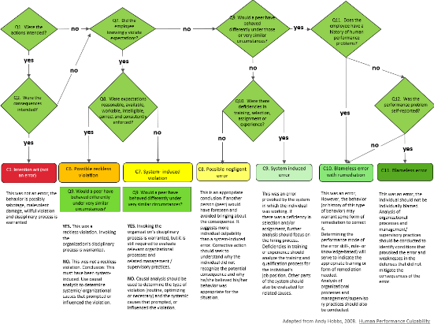
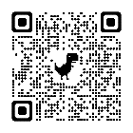
RM13010 – Human Factors
New content includes,
Hazard reporting example
Investigation example questions
Avoidance of the “Blame Cycle”
Error Zone Assessment example
HF FMEA Example
Wording clarifications
Useful video, podcast & article links
Investigation Interview guide example
Error/ Violation decision tree example
HF considerations for 8D
Example Communications
HF Deployment Framework example
Updated
Download Here
Join the AESQ human Factors Community of Practice on LinkedIn.

Slide 9
AESQ Quality Management System Requirements for Aero Engine Design and Production Organizations, AS13100
We have put some Human Factors related parts in this standard
Category
Quality Management System and its Processes
Establishing the Quality Policy
Management Review Inputs
Problem Solving Methods for Customer Escapes
Human Factors Awareness
Leadership

Slide 10
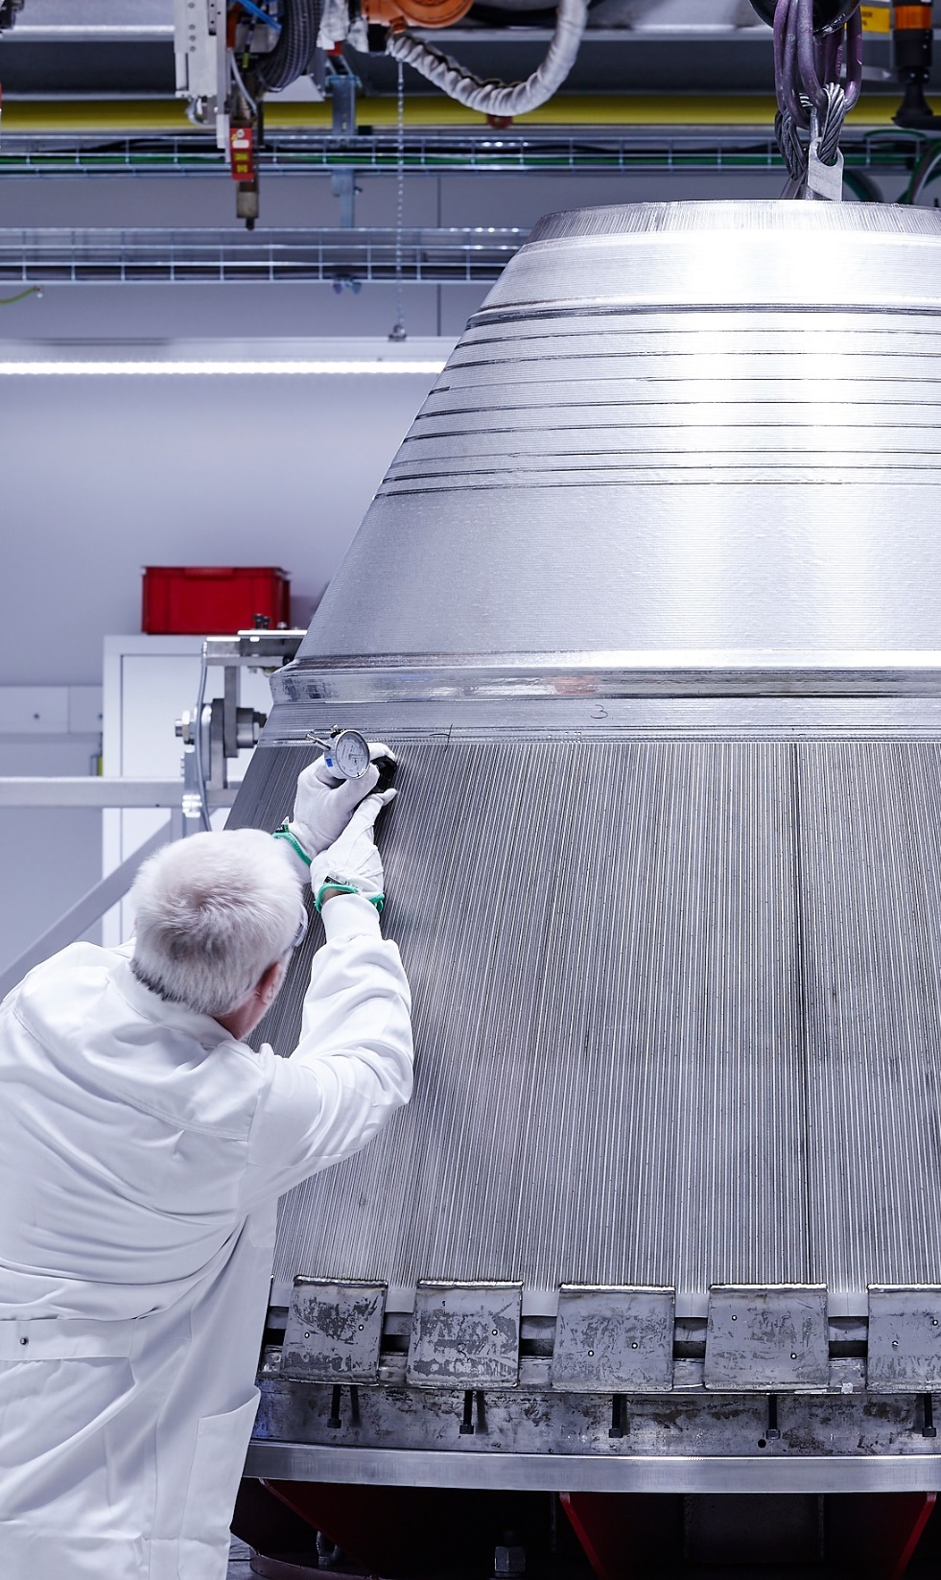
INTRODUCTION
HUMAN FACTORS REPORTING
Refers to the reporting, collection and evaluation of human factor related events, hazards, or improvement opportunities.
The purpose of this reporting is to ensure that the organization learns from these and reduces the error opportunity.
These reports may be part of the organizations existing incident reporting process or a separate process specifically for Human Factor related issues. Reports may be raised as a result of an event (nonconformance, customer escape, rework, etc.) or by a staff member, including those raised by the confidential reporting line.

Slide 11
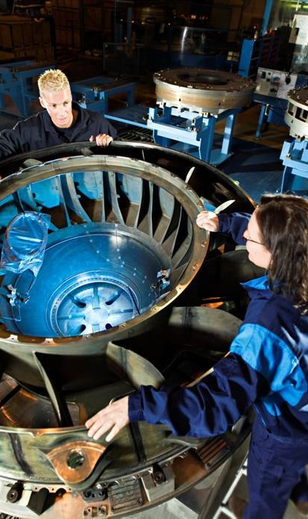
Quality Management System and its Processes - Supplemental Requirements
The organization’s Quality Management System shall include Management of Human Factors in its processes (5.1.1.1) including:
Training of employees.
An open reporting culture, encouraging the sharing of mistakes without fear of retribution.
Considering Human Factors in investigations.
Considering Human Factors in the reporting of performance and identifying improvement plans.
Human Factors should be an integrated part of product and service design, manufacturing/assembly, and product servicing.
NOTE: For details on the deployment of Human Factors within the organization, see RM13010.

Slide 12
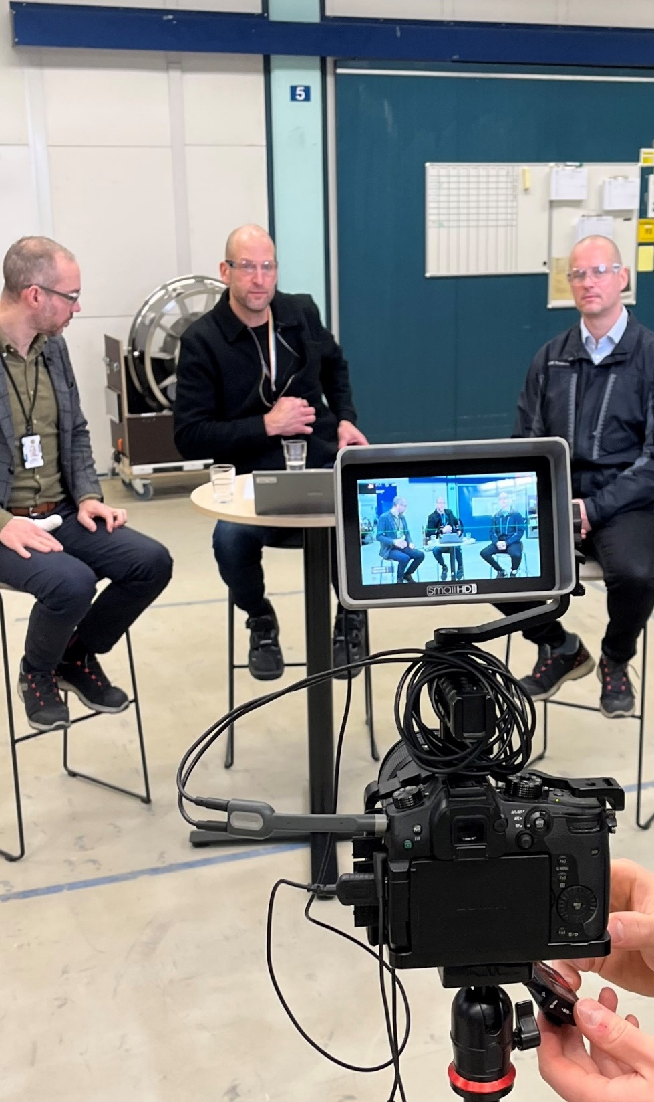
LEADERSHIP
General - Supplemental Requirements
Top Management shall demonstrate a commitment to Human Factors in accordance with 4.4.3 and 7.3.1, see RM13010.

Slide 13
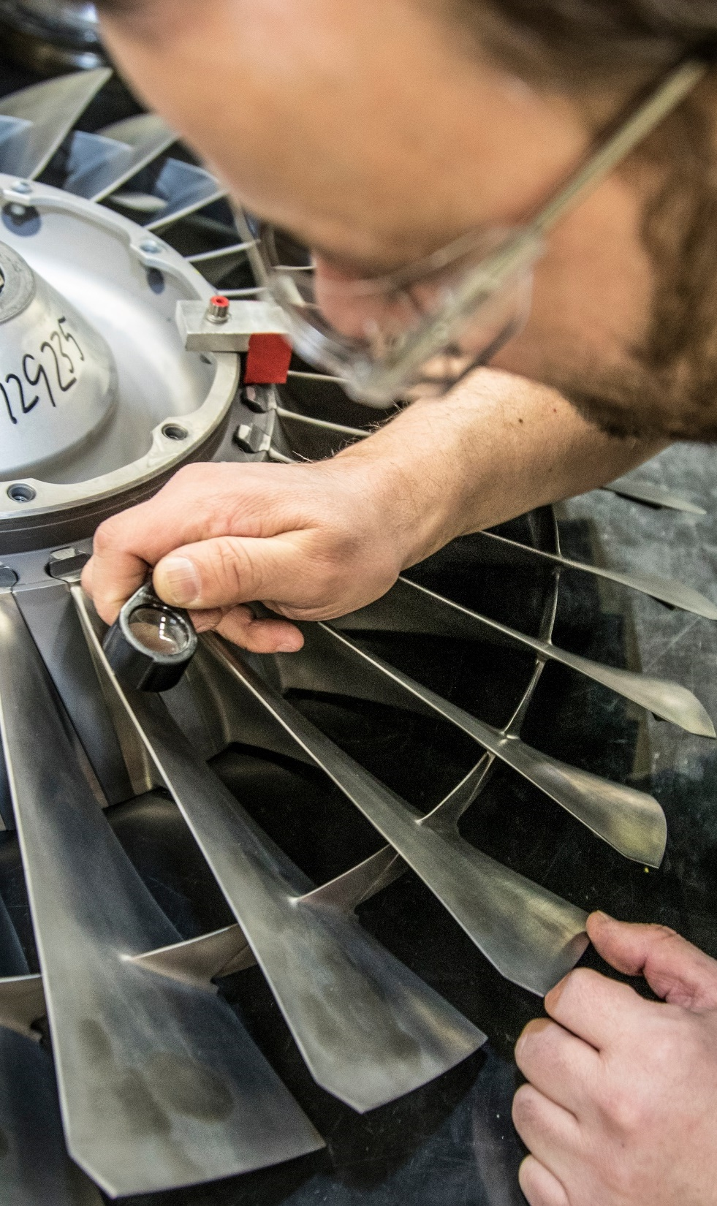
Establishing the Quality Policy - Supplemental Requirements
The organization shall have a policy that includes Human Factors which promotes:
Open Reporting.
Continually improving the maturity of Human Factor deployment within the organization

Slide 14
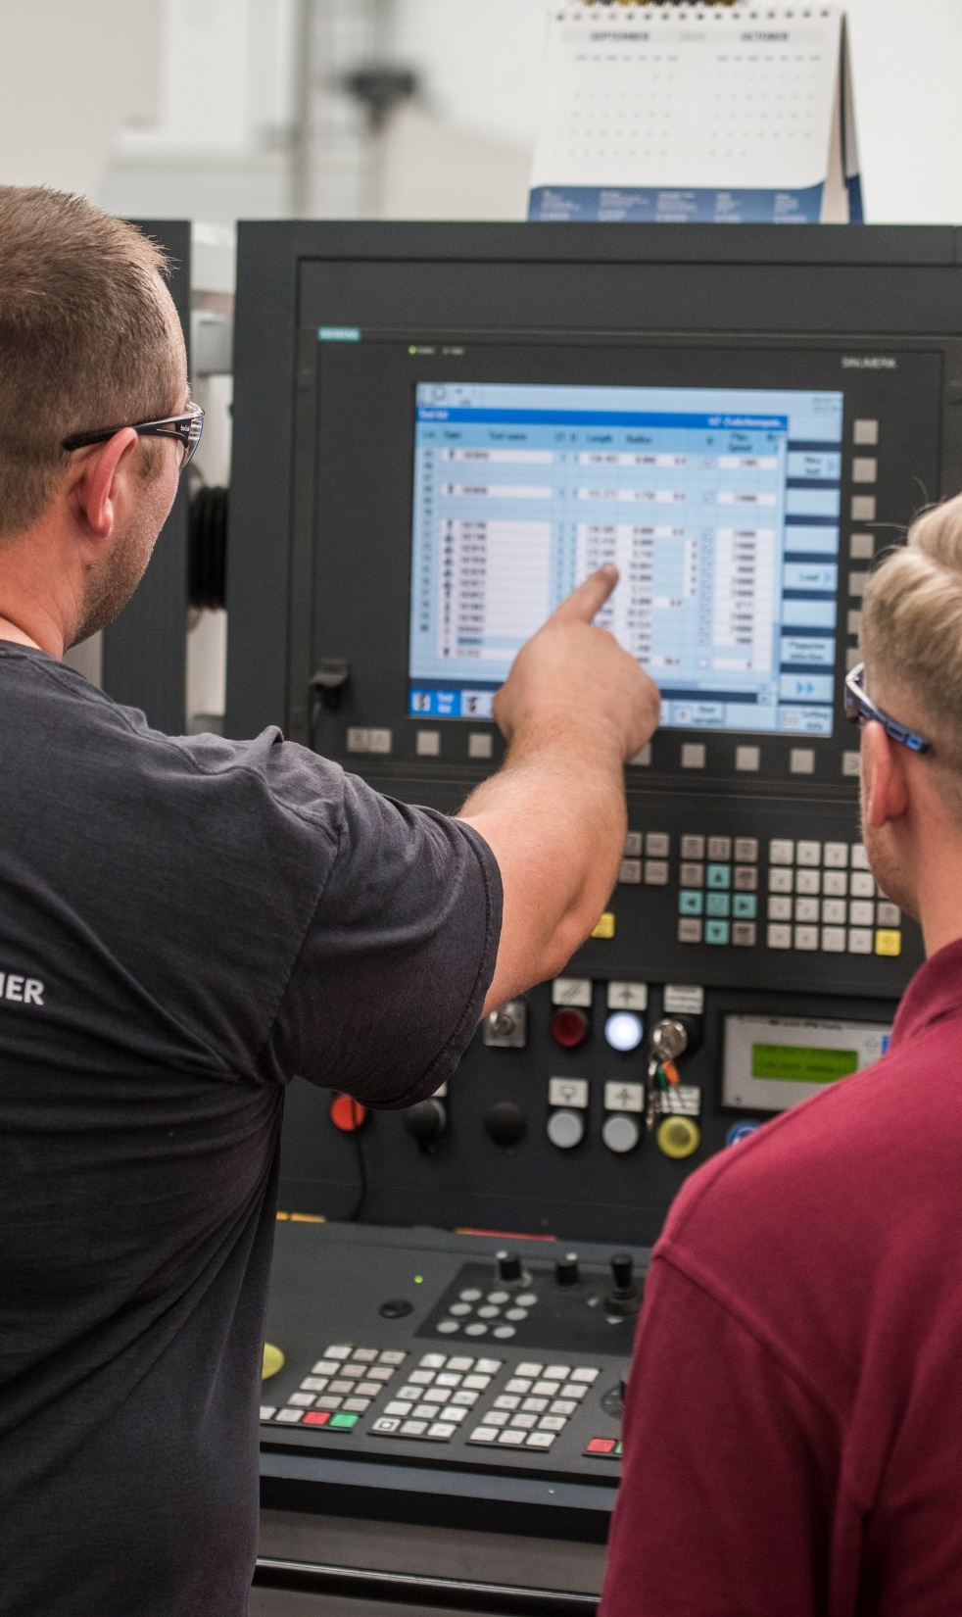
Awareness
Human Factors Awareness - Supplemental Requirements
The organization (5.1.1.1) shall provide an appropriate program of training and awareness of Human Factors based on role, see RM13010.

Slide 15
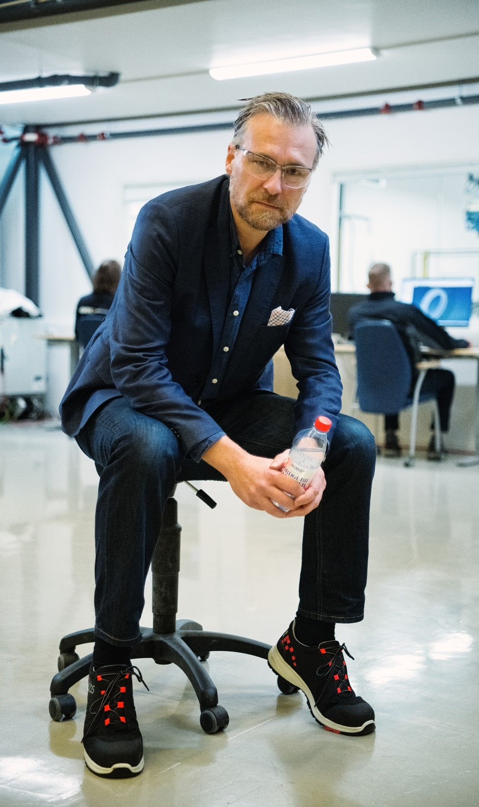
Management Review Inputs - Supplemental Requirements
Management Reviews shall be conducted at least annually and consider the following performance topics:
Cost of Poor Quality (COPQ).
Manufacturing/Assembly Right First Time/First Pass Yield.
Customer scorecards (where available).
Human Factors reporting.

Slide 16
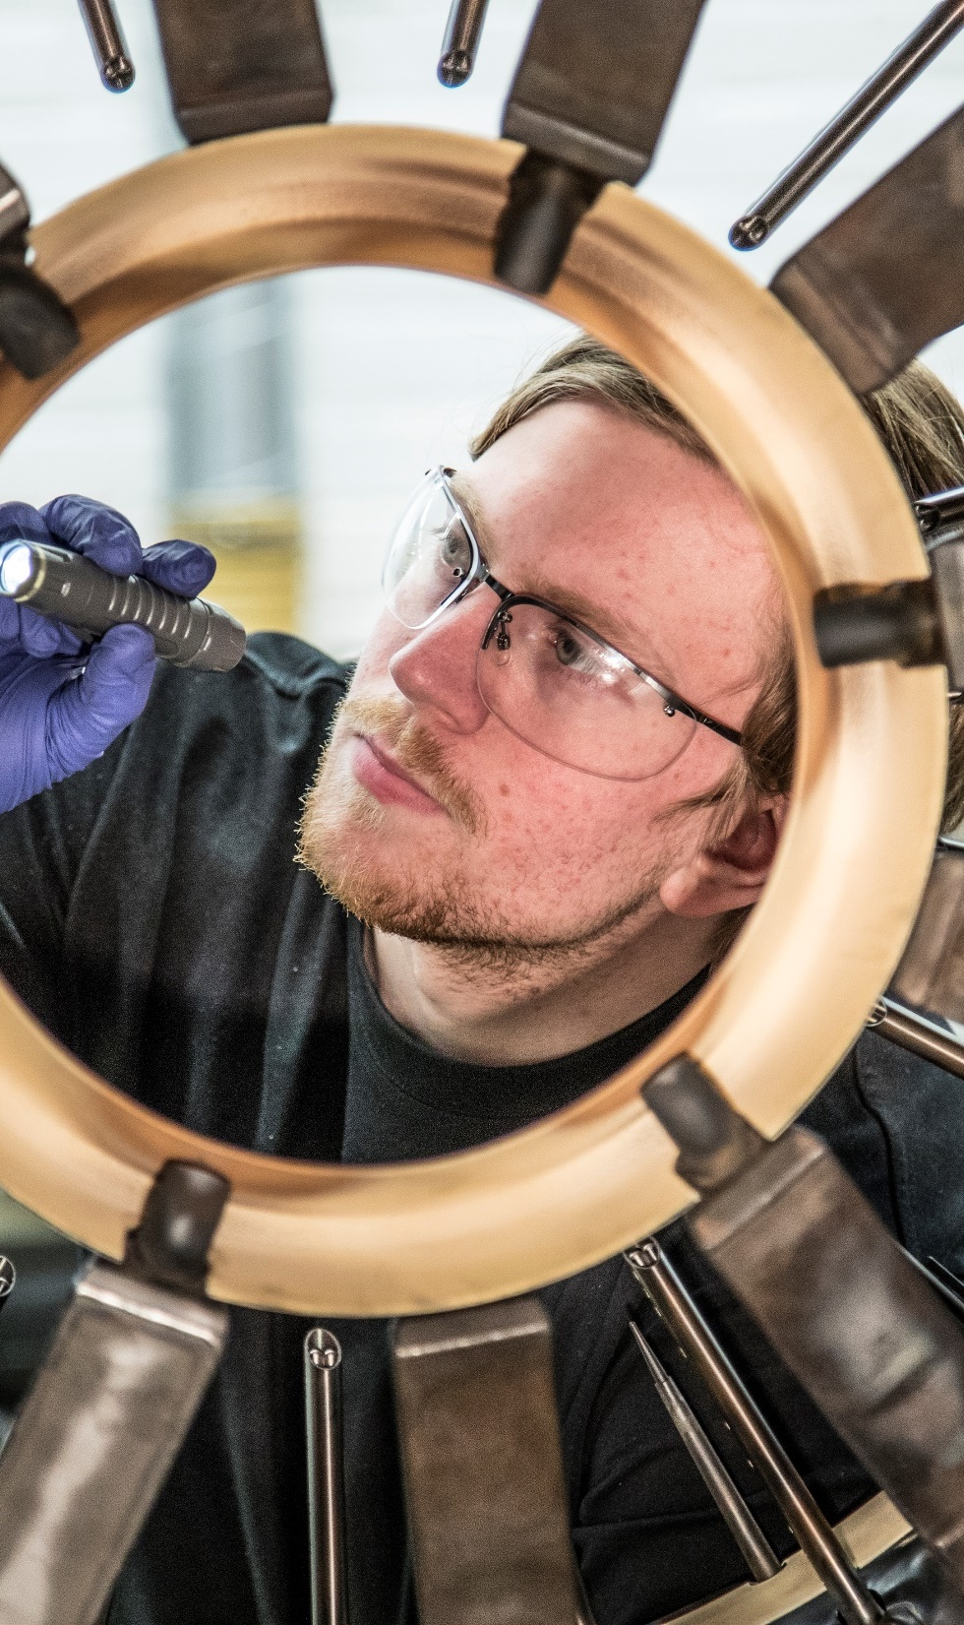
Problem Solving Methods for Customer Escapes - Supplemental Requirement
The organization shall have a criteria and approach defined for recognizing and addressing Human Factors causes in investigations, e.g., Maintenance Event Decision Aid, see RM13010.

Slide 17
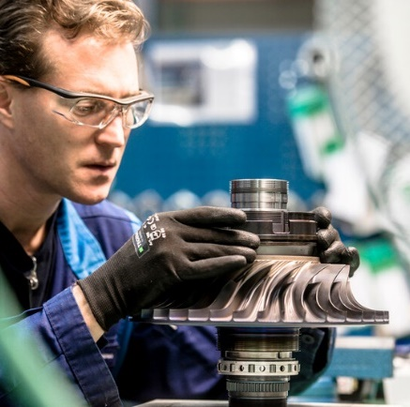
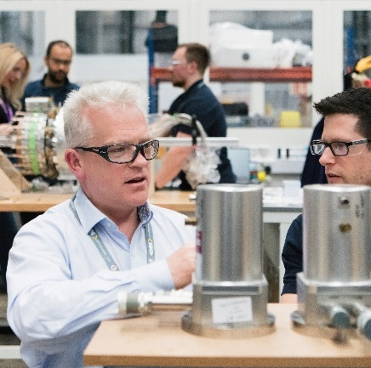

Challenges to us
Webinar to introduce A13100 Human Factors elements and RM13010 guidance material
Using industry experience to build communication and awareness kits
Creating material and support tailored to smaller companies
Developing a library of Best Practice Applications of RM13010 elements to upload onto this website.
Reviewing and updating RM13010
RM13010 Human Factors Poster
Smaller companies, suppliers, adaption of the requirements
Maturity in organisations
Line in the sand
Culpability matrix
Acceptable/Unacceptable behaviour

Slide 18
Extras

Slide 19
AESQ Quality Management System Requirements for
Aero Engine Design and Production Organizations

