Slide 1
Real-time Snow and Cloud Animation in Computer Graphics
Dr. Prashant Goswami
Associate Professor, Computer Science
Blekinge Institute of Technology (Sweden)
https://prashantgos.github.io/
prashant.goswami@bth.se

Slide 2
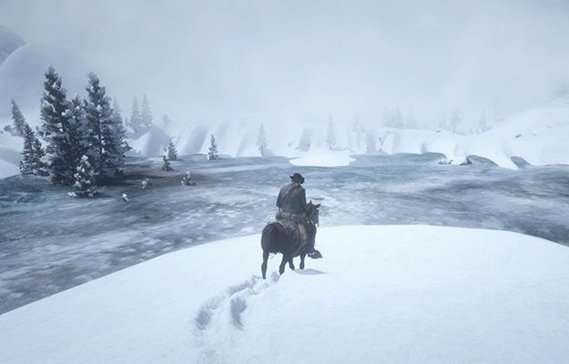
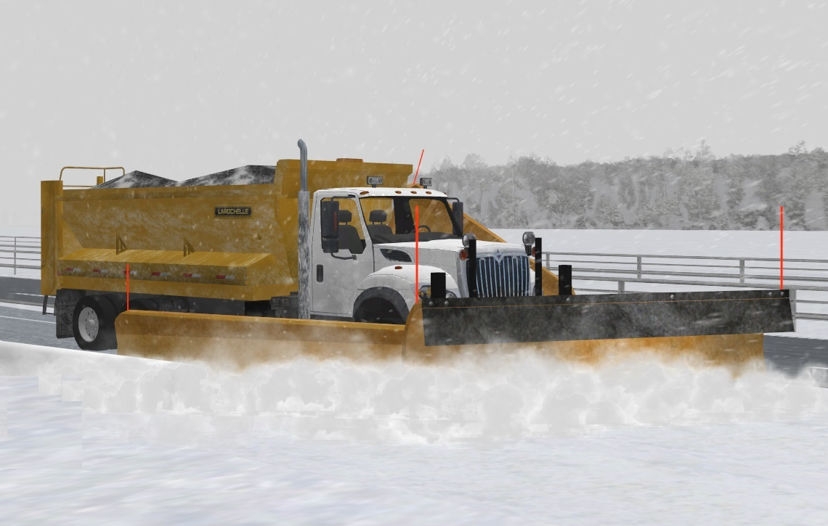
Snow in Computer Graphics
Red Dead Redemption 2
Snow simulation essential in CG
Computer games, movies, virtual simulators
Snow simulation computationally intensive
Compared to fluids, sand, cloth, ..
Most existing solvers focus on accurate behavior
Computationally expensive, offline
We need to accelerate snow simulation
Virage Simulation
Notes:
-- Not all applications require an accurate simulation. Some need efficiency

Slide 3
Method - 1
Discrete Element Method (DEM)
Base DEM solver
Two extreme radii (rs and ri)
Particle state determined using η
Compression
Normal and tangential forces
Bonds between particles
GPU-based
Completely parallel
rs
η
ri
Ice
Snow

Slide 4
Method - 1

Slide 5
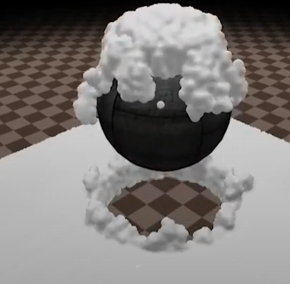
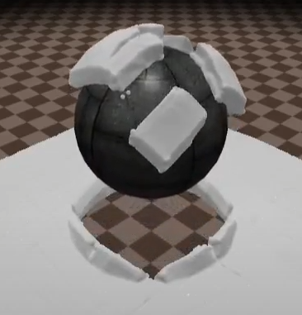
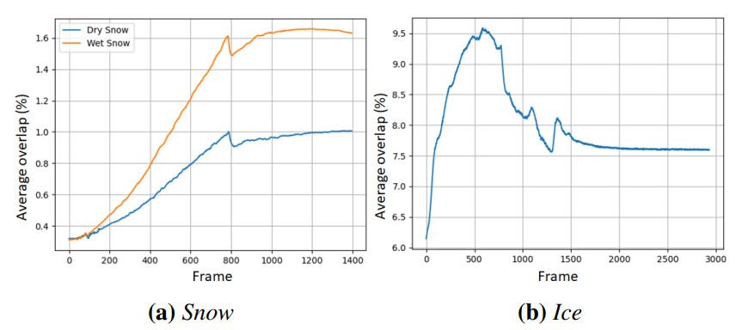
Method - 2
Limitations with Method – 1
Small time step (0.1 ms)
Stability issues
We improved the method using same base
Global iterative fixing of error
To minimize overlap error
Wet and dry snow behaviors
Existing boundary handling incorporated

Slide 6
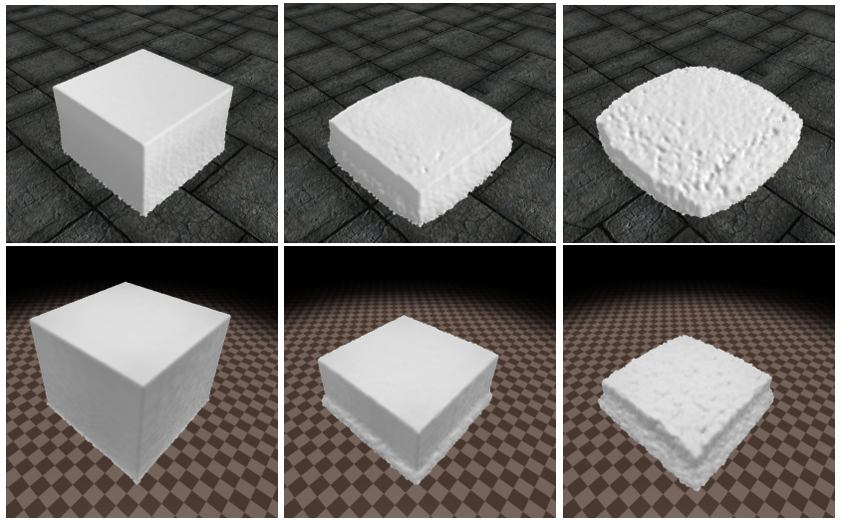
Method - 2
We improved the method using same base
Time step 10x (1 ms)
Upto 8.66x faster (1 million particles)
Better Stability
User study to validate our approach
GPU-based
Completely parallel
Goswami et al. 2019
Goswami et al. 2022

Slide 7
Method - 2

Slide 8
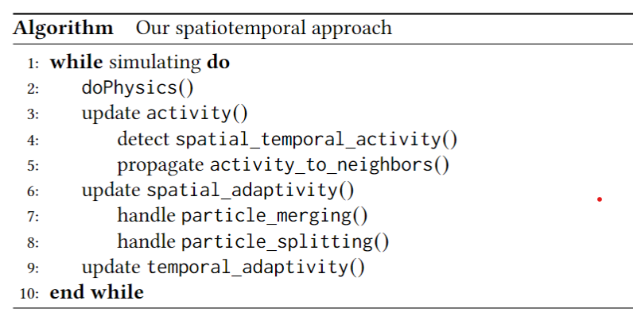
Method - 3

Slide 9
Method - 3
About 3.5x faster than the iterative approach

Slide 10
Related work - Snow

Slide 11
Clouds
Clouds ubiquitous in applications
Landscapes, flight simulators
Computationally expensive
Too much data to compute
Cloud + invisible air
Scale of the problem big
Do we need this much in CG?

Slide 12
Method - 1
Decompose physics and visualization
Simulate physics in large parcels
Add hypertexture for visualization
Low computational overhead
Implicit atmosphere
Low memory overhead

Slide 13
Method - 2
Animate clouds using AI
DCGAN
Learn from user-captured videos
No physics
Link:
https://ardisdataset.github.io/Cloud/
Notes:
Deep Convolutional Generative Adversarial Network (DCGAN)

Slide 14
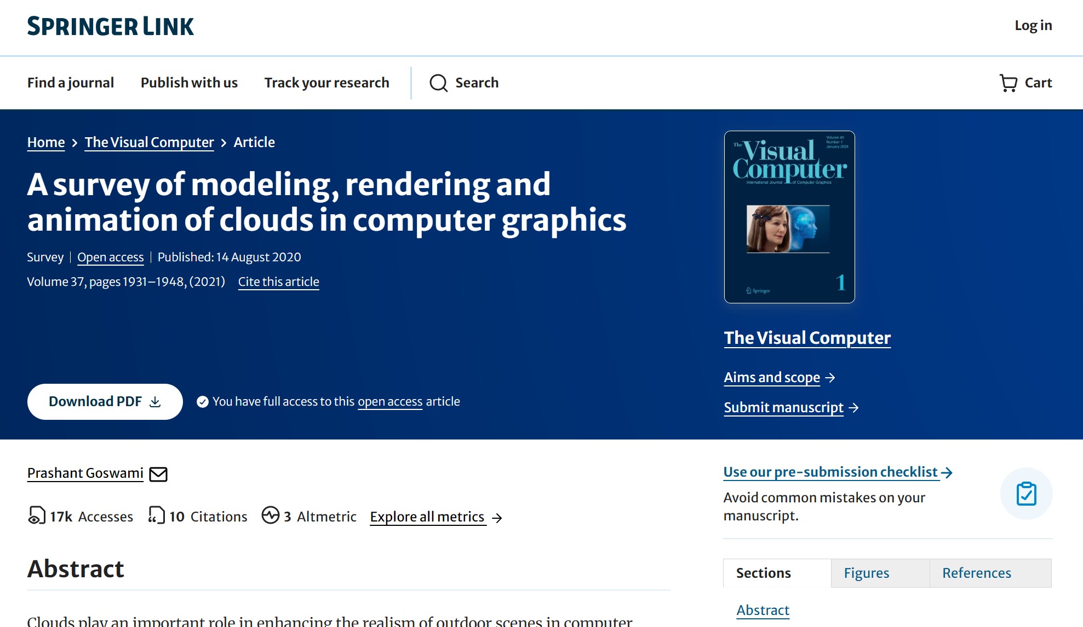

Slide 15
My focus
To collaborate
With industry for addressing their need
Joint funding proposals
Industrial PhD students
With academia for high-quality research
Joint funding proposals
Joint supervision
https://prashantgos.github.io/
prashant.goswami@bth.se

